Slide 1
Defensive Security Project
by: Chris Akatcherian

Slide 2
Table of Contents
This document contains the following resources:
Monitoring Environment
Attack Analysis
Project Summary & Future Mitigations

Slide 3

Monitoring Environment
‹#›

Slide 4
Scenario
Our team investigated cyberattacks on VSI’s Windows and Apache servers, suspected to be carried out by JobeCorp, to evaluate the effectiveness of our monitoring solutions. Using Splunk, we analyzed logs to identify suspicious activities, such as unusual user behavior, irregular HTTP methods, and international traffic spikes. Through dashboards, alerts, and reports, we identified patterns of malicious activity and developed actionable insights to enhance VSI’s security posture.

Slide 5
“Add-On” App
‹#›

Slide 6
Website Monitoring App
Summary
Features
Monitor websites to detect downtime and performance problems. This app uses a modular input that can be setup easily (in 5 minutes or less)
Uptime Calculation- Using the Status History dashboard, information is provided about past failures and calculates the website’s uptime percentage.
Status Monitoring Dashboard- provides the response time for your monitored websites and provides historical analysis of the site’s responsiveness
Email outage Alerting- Get emailed when website is down
Change History Dashboard- Provides info regarding when the monitored pages change

Slide 7
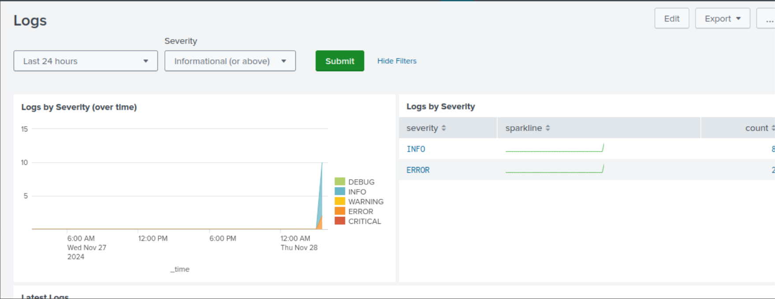
Website Monitoring App - Scenario Benefits
Allows for real-time monitoring of any Logs, such as by severity as well as when they occured

Slide 8
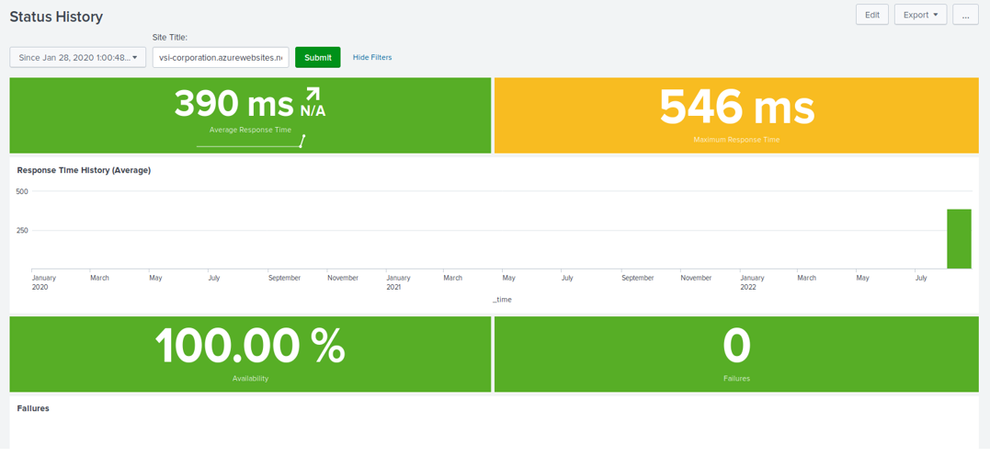

Slide 9
Logs Analyzed
Windows Logs
Apache Logs
1
2
Logs for VSI’s Windows server
-windows_server_logs.csv
-windows_server_attack_logs.csv
Logs for VSI’s main public-facing website, vsi-company.com
- apache_logs.txt
- apache_attack_logs.txt

Slide 10
Windows Logs
‹#›

Slide 11
Reports—Windows
Designed the following reports:
Report Name | Report Description
Report Analysis for Severity | Search query report for biggest changes in high severity events in the Attack logs
Report Analysis for Failed Activities | Search query report for biggest changes in Failed Activities in the attack logs
Analysis for Successful Logins | Search query report that tracked the amount of successful logins in Normal logs vs Attack Logs

Slide 12
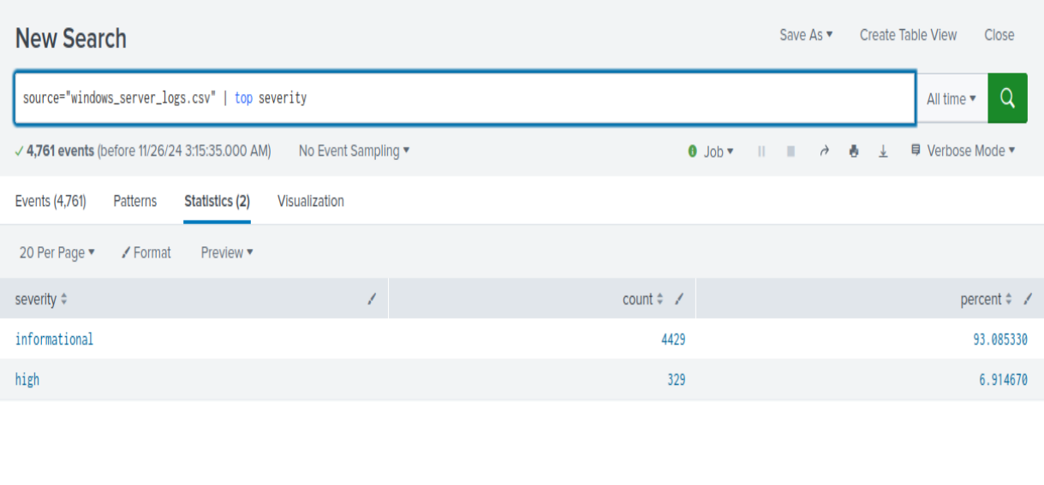
Normal Logs - Severity

Slide 13
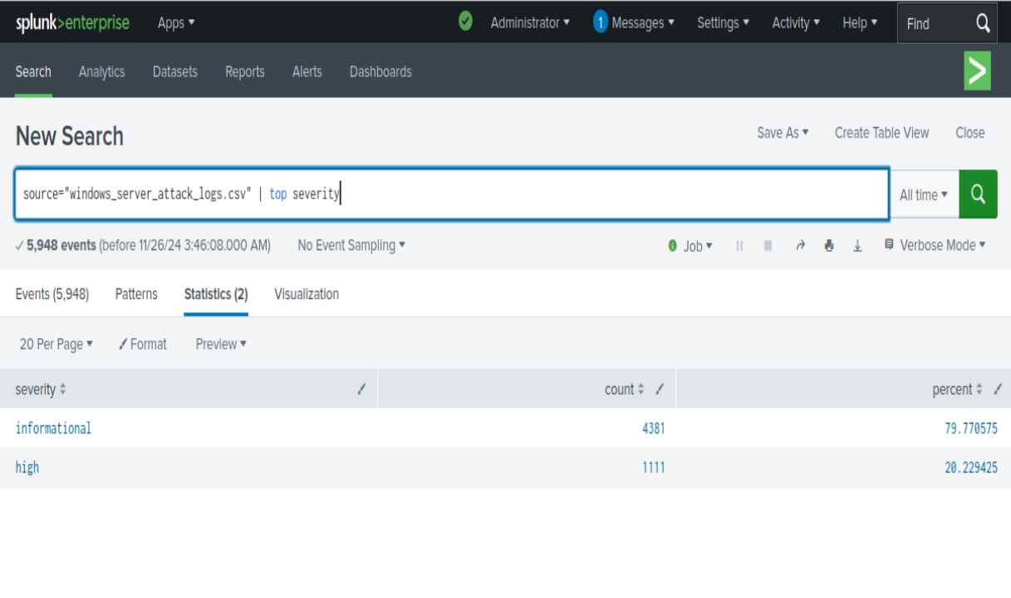
Attack Log - Severity
We detected changes in severity with The value increasing from 7% to 20% during the attack

Slide 14
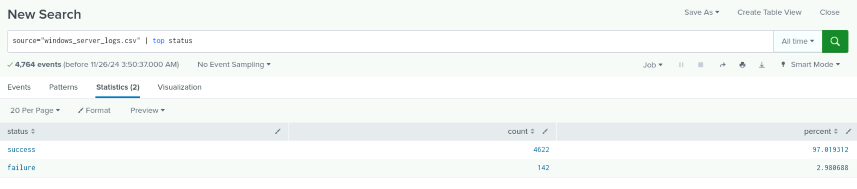
Failed Activities - Normal Logs

Slide 15
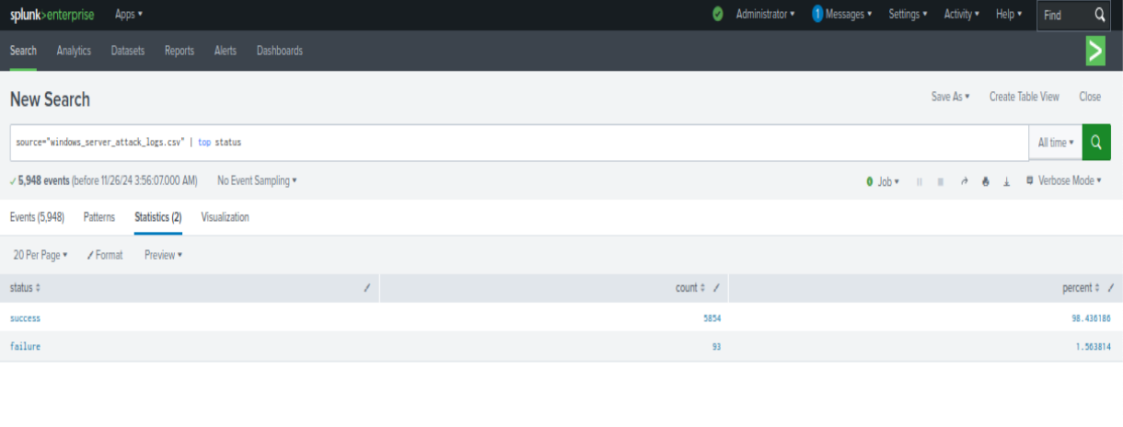
Failed Activities - Attack Logs
we detected suspicious changes in failed activities between normal and attack logs. There was an increase in successful activities and decrease in failed activities

Slide 16
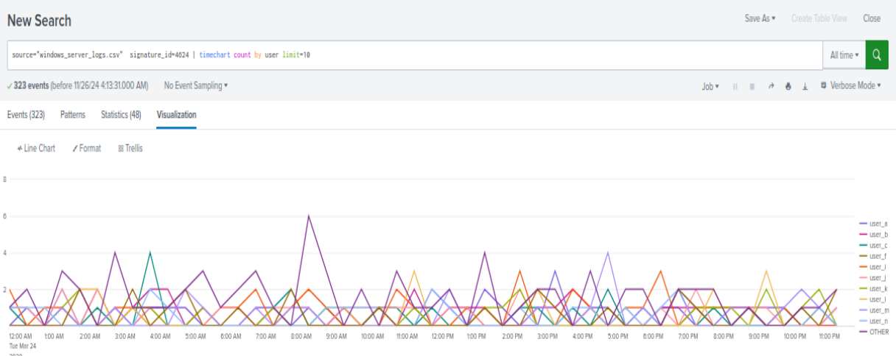
Analysis for Successful Logins - Normal Log

Slide 17
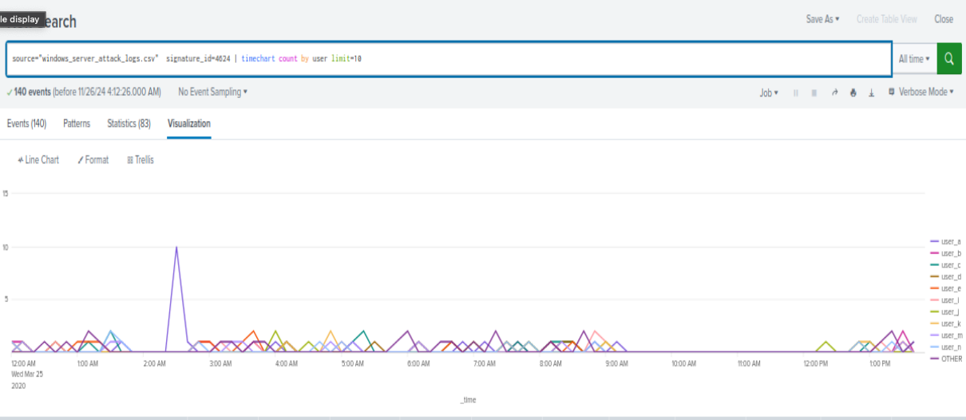
Analysis for Successful Logins - Attack Log
Upon further review of the logs, user_a logins spiked at around 2:30am with 10 logins, Which indicates a successful attack

Slide 18
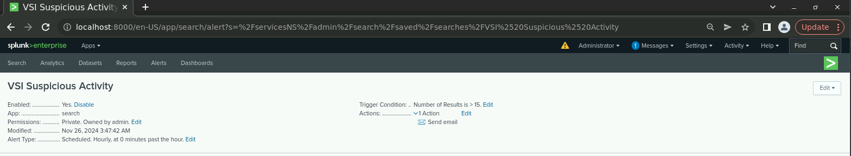
Alerts—Windows
Designed the following alerts:
Alert Name | Alert Description | Alert Baseline | Alert Threshold
VSI Suspicious Activity | Threshold of failed Windows Activity reach | 8 | 15
JUSTIFICATION: Failures exceeding 15 would certainly indicate suspicious activity, as the average amount of failed Windows activity averaged around 8 as our baseline.

Slide 19
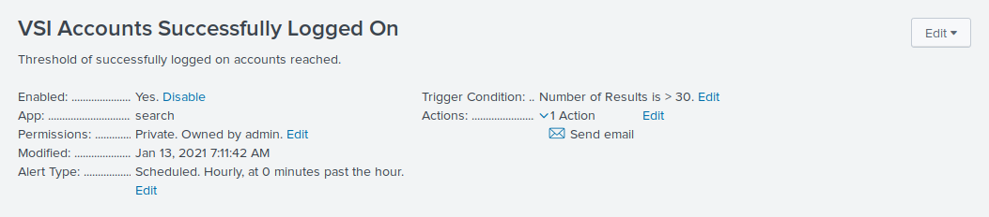
Alerts—Windows
Designed the following alerts:
Alert Name | Alert Description | Alert Baseline | Alert Threshold
VSI Accounts Successfully Logged On | Threshold of Successful Logged on by Account | 12 | 30
JUSTIFICATION: The average amount of failed Windows activity averaged around 12 to establish our baseline yet never got close to 30. Failures exceeding 30 would certainly indicate suspicious activity.

Slide 20
Alerts—Windows
Designed the following alerts:
Alert Name | Alert Description | Alert Baseline | Alert Threshold
VSI Deleted User Accounts | Threshold of Deleted Users Accounts | 13 | 50
JUSTIFICATION: A baseline of 13 seemed on par with a “normal” hour. Exceeding 50 would raise suspicion levels and indicate a problem

Slide 21
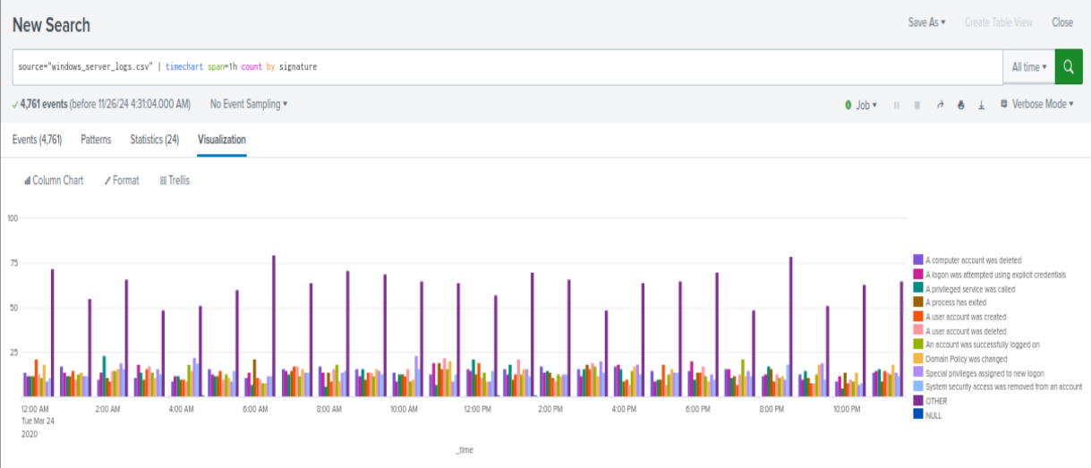
Dashboard - Signature

Slide 22
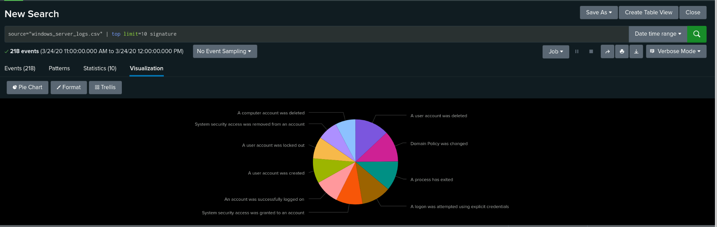
Signature Pie Chart

Slide 23
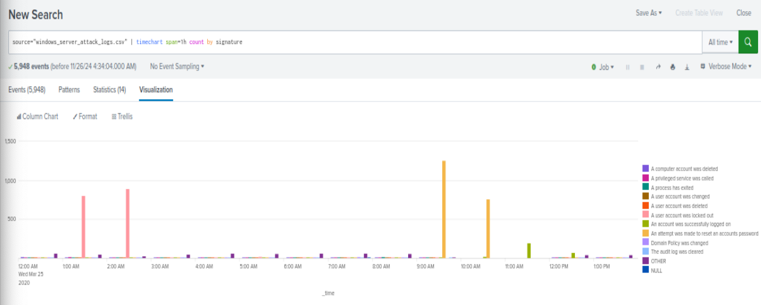
Dashboard - Signature (Attack Logs)

Slide 24
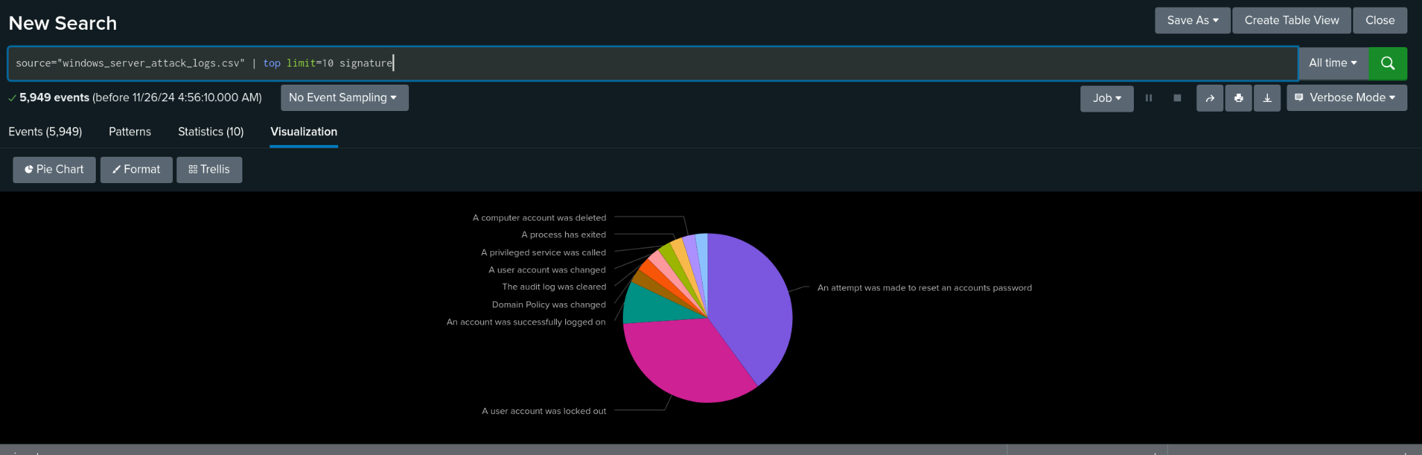
Signature Pie Chart (Attack Logs)

Slide 25
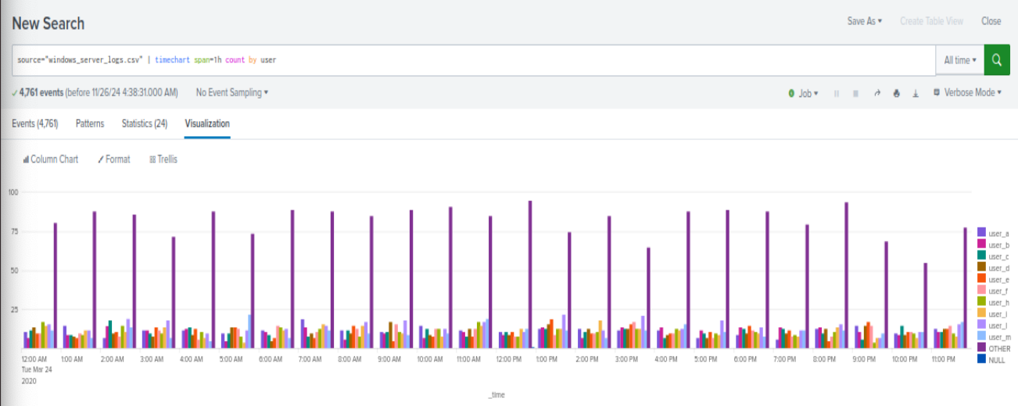
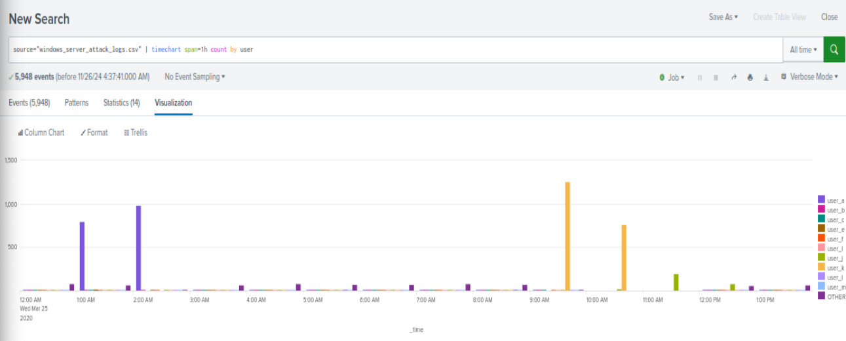
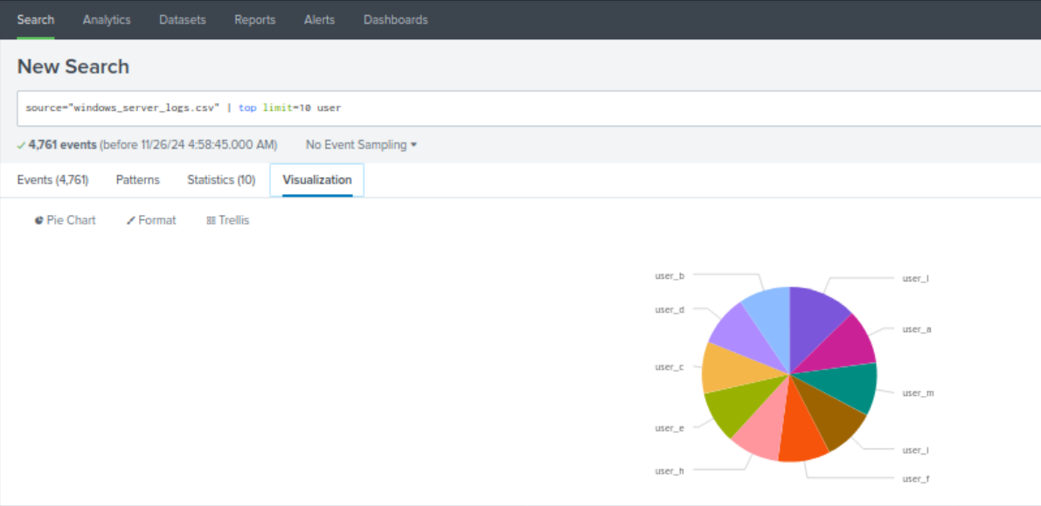
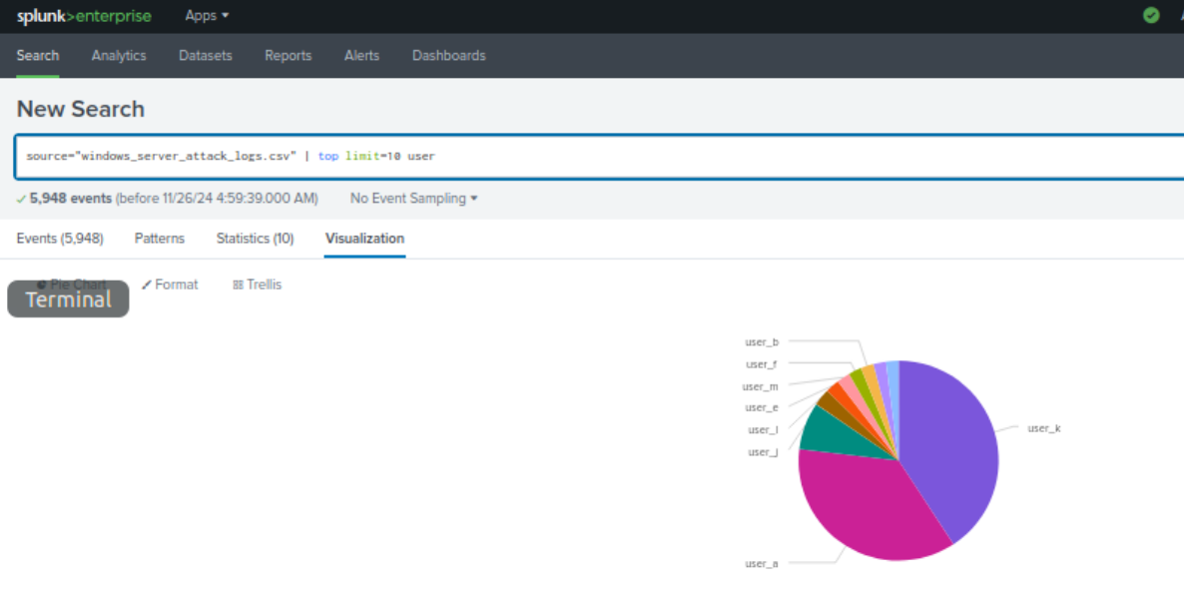
Dashboards—Windows
Normal Logs
Attack Logs
Place image here
Place image here
Place image here
Place image here

Slide 26
Dashboard - Users

Slide 27
Dashboard Pie Chart - Users

Slide 28
Dashboard - Users (Attack Logs)

Slide 29
Dashboard Pie Chart - Users (Attack Logs)

Slide 30
Apache Logs
‹#›

Slide 31
Reports—Apache
Report Name | Report Description
HTTP Methods | Detected suspicious changes in HTTP methods, specifically with POST there was an increase of 1,218 during the attack
Top 10 Referrer Domains | Saw some changes in the results of the top 10 referrer domains, specifically with the last 5 of the list
Count of HTTP Response Code | Detected a suspicious change in HTTP response codes, specifically with response code 200 and 404. Response code 200 had a significant decrease while response code 404 saw an increase during the attack.
International Activity | A volume of suspicious international activity was detected. 937 on March 20, 2020 at around 12 AM

Slide 32
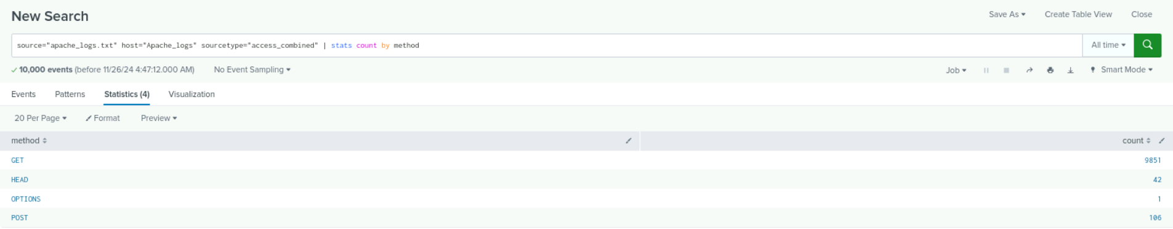
Images of Reports - HTTP Methods - Normal Logs
Normal Apache Logs:
Attack Logs:
Notes:
Here we have the comparison of the GET and POST by count.

Slide 33
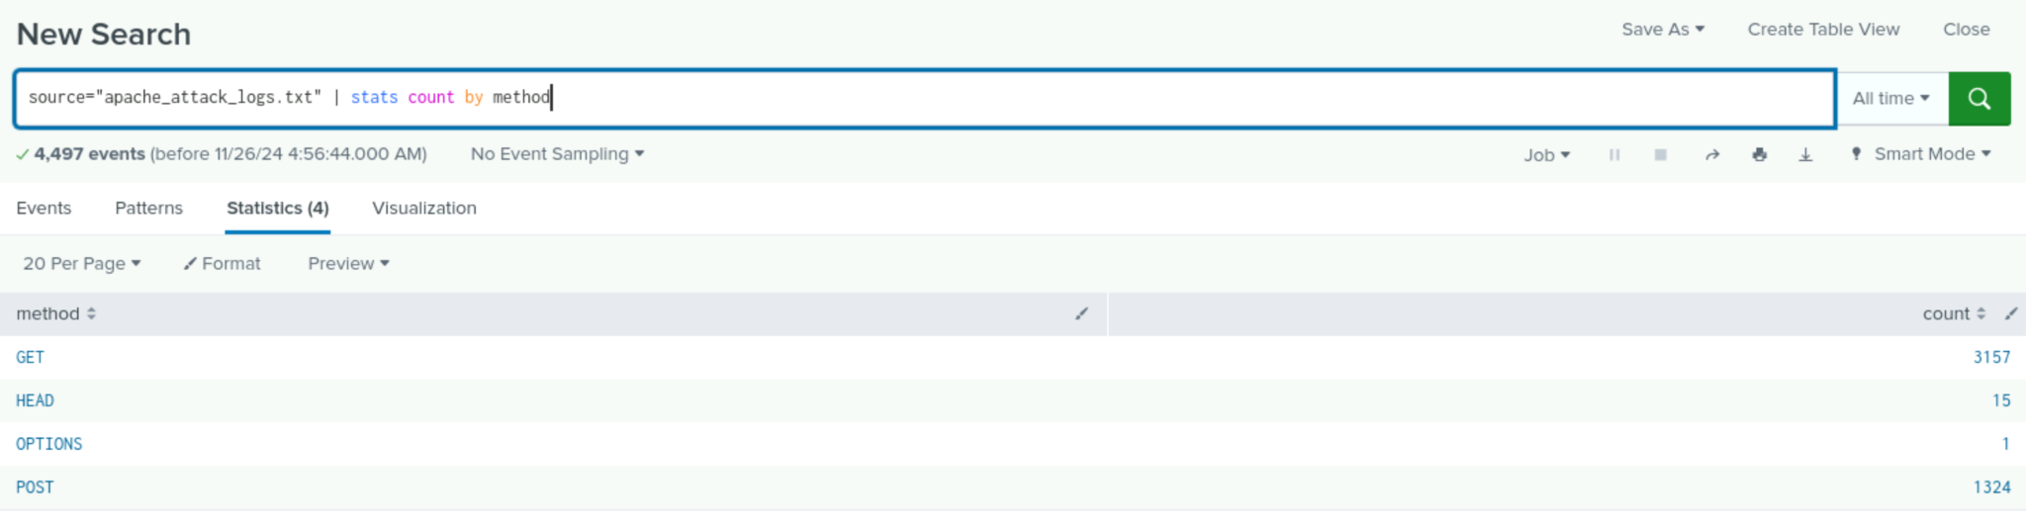
Images of Reports - HTTP Methods - Attack Logs
Normal Apache Logs:
Attack Logs:
Detected suspicious changes in HTTP methods, specifically with POST there was an increase of 1,218 during the attack
Notes:
a surge in POST requests could indicate that an attacker is attempting to submit data to a server

Slide 34
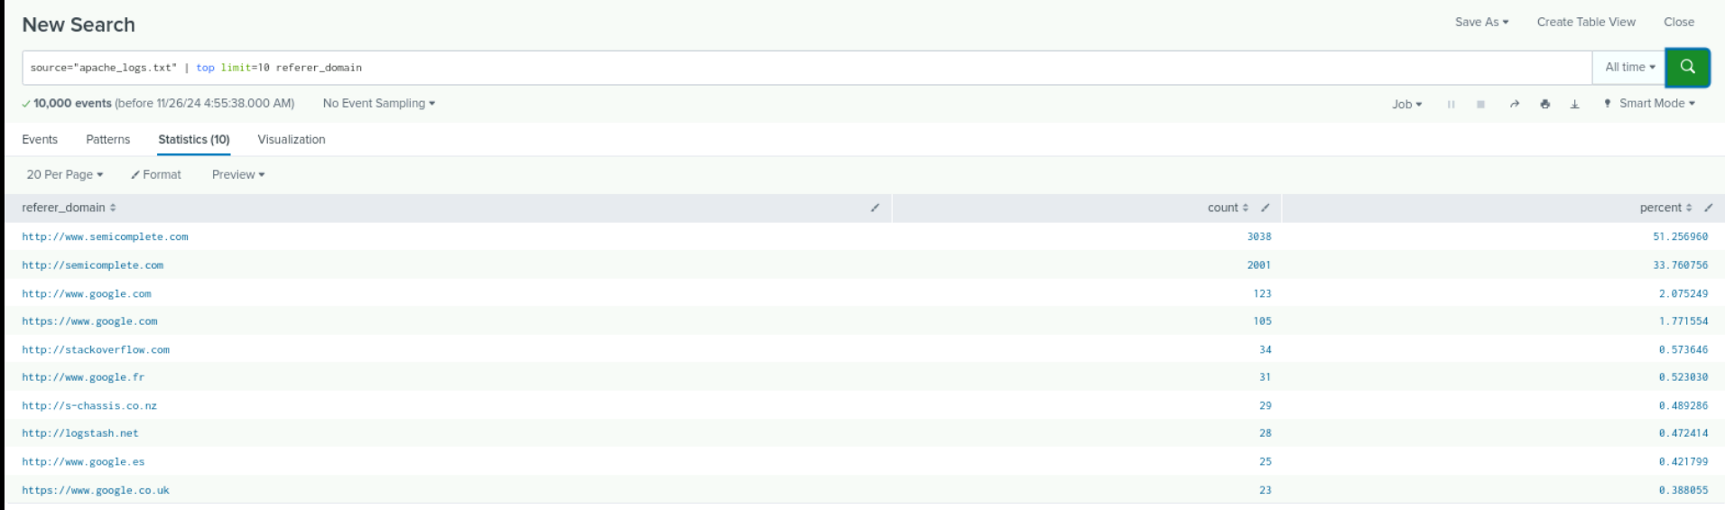
Images of Reports - Top 10 Referrer Domains - Normal Logs
Notes:
We detected some changes in the top 10 referrer domains especially in the last five entires

Slide 35
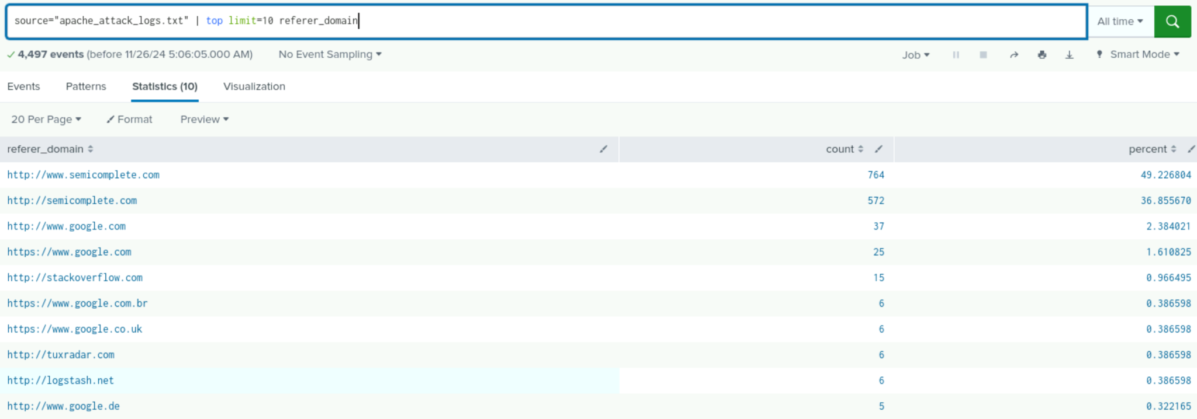
Images of Reports - Top 10 Referrer Domains - Attack Logs
We saw some changes in the results of the top 10 referrer domains, specifically with the last 5 of the list
Notes:
This could point to malicious traffic from untrusted sources

Slide 36
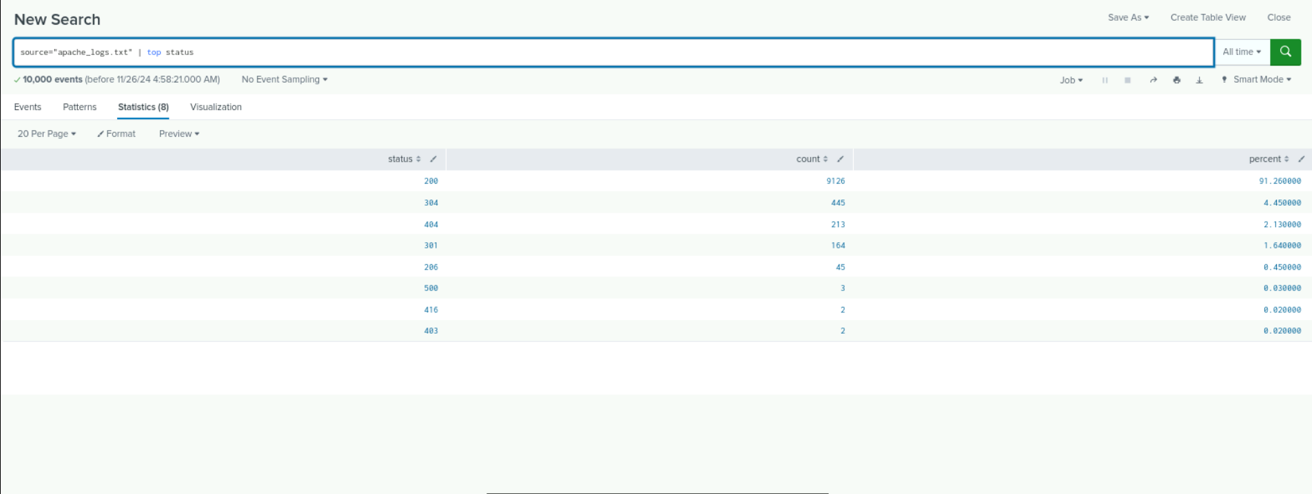
Count of HTTP Response Code - Normal Logs
Notes:
There was a significant change in HTTP response codes, specifically a decrease in response codes.

Slide 37
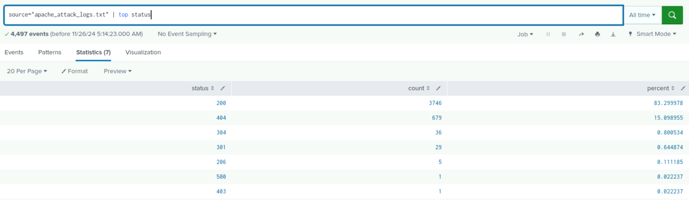
Count of HTTP Response Code - Attack Logs
We detected a suspicious change in HTTP response codes, specifically with response code 200 and 404. Response code 200 had a significant decrease while response code 404 saw an increase during the attack.
Notes:
This is important because this could mean normal traffic is being blocked or redirected and an increase in 404 errors might point to an attacker probing the server

Slide 38
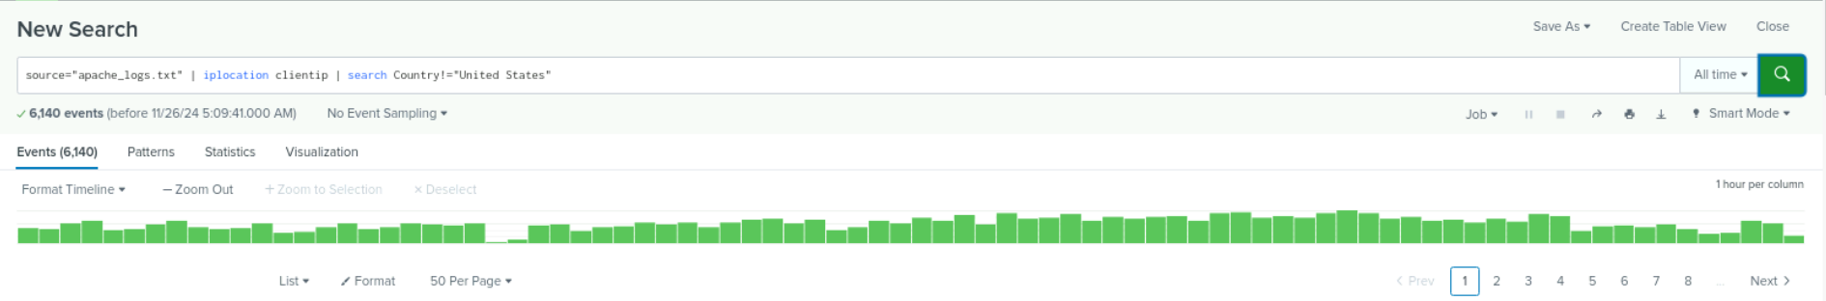
International Activity - Normal Logs
Notes:
We detected a volume off suspicious international activity.

Slide 39
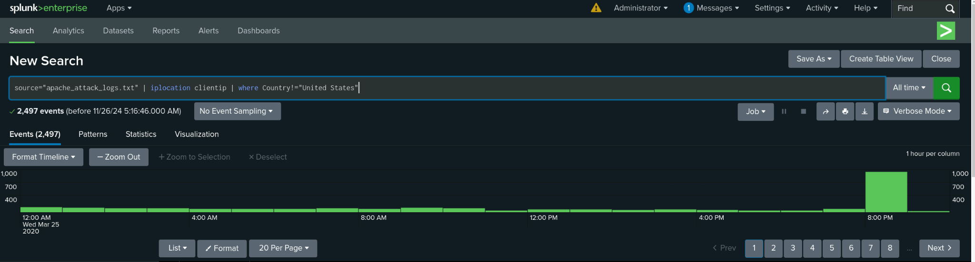
International Activity - Attack Logs
Detected an Increase of 937 in activity outside of the US during the attack
Notes:
The increase of activity especially if it is outside of where business is typically done suggest an attack (brute force)

Slide 40
Alerts—Apache
Designed the following alerts:
Alert Name | Alert Description | Alert Baseline | Alert Threshold
VSI non-USA Activity | Alert if the hourly activity from any country besides the United States exceeds the threshold | 120 | 150
JUSTIFICATION: 120 events in a hour seemed standard in the logs, yet exceeding 150 seemed unlikely on a normal day. Seeing any number of events greater than the threshold would indicate issues

Slide 41
Alerts—Apache
Designed the following alerts:
Alert Name | Alert Description | Alert Baseline | Alert Threshold
HTTP POST Activity | Alert if there is a significant spike in POST and GET activity | 3 | 12
JUSTIFICATION: Helps detect unusual behavior that may indicate potential security threats. This alert provides visibility into sudden spikes in POST requests.

Slide 42
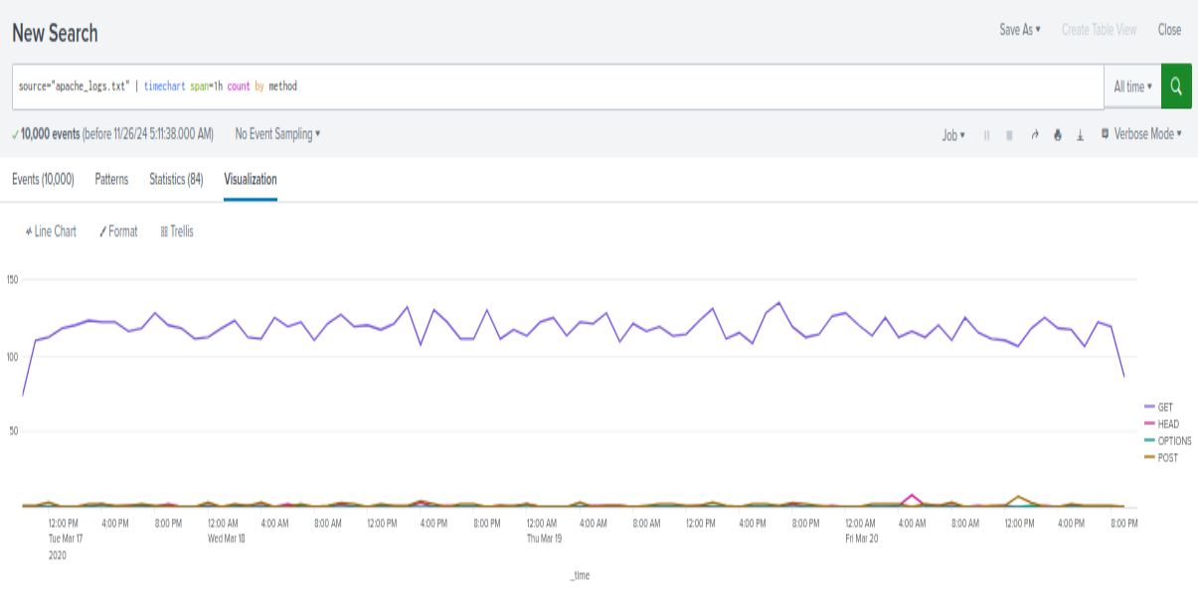
Dashboard Analysis for Time Chart of HTTP Methods - Normal Logs

Slide 43
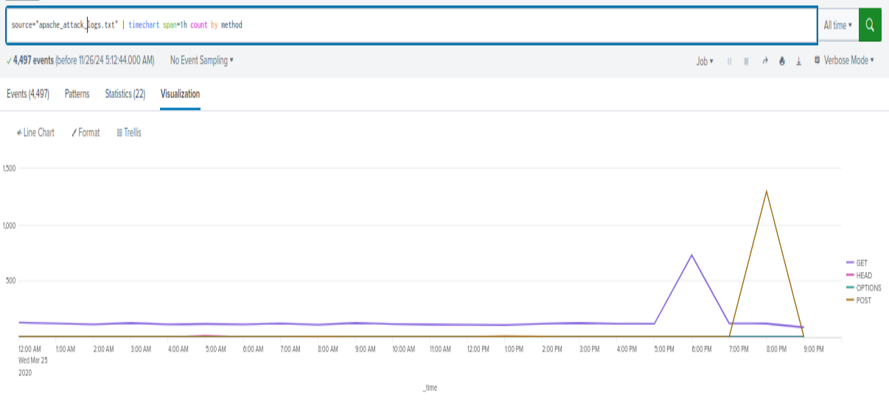
Dashboard Analysis for Time Chart of HTTP Methods - Attack Logs
we can see a significant spike in the POST and GET Method

Slide 44
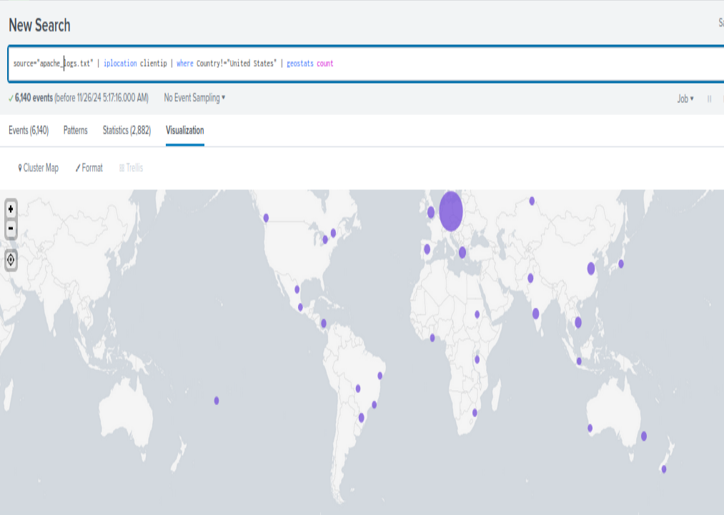
Dashboard Analysis for Cluster Map - Normal Logs

Slide 45
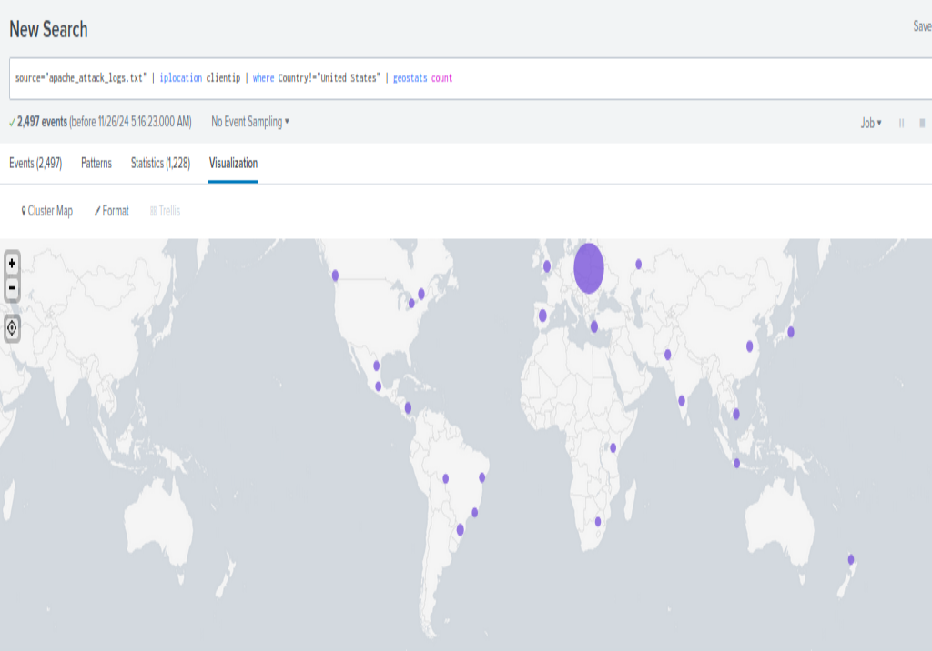
Dashboard Analysis for Cluster Map - Attack Logs
There was a major increase in Kiev and Karkhev

Slide 46
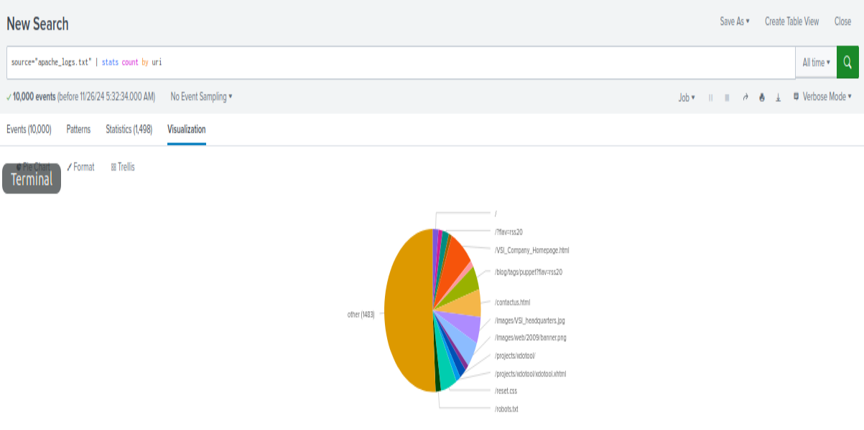
Dashboard Analysis for URI Data - Normal Logs

Slide 47
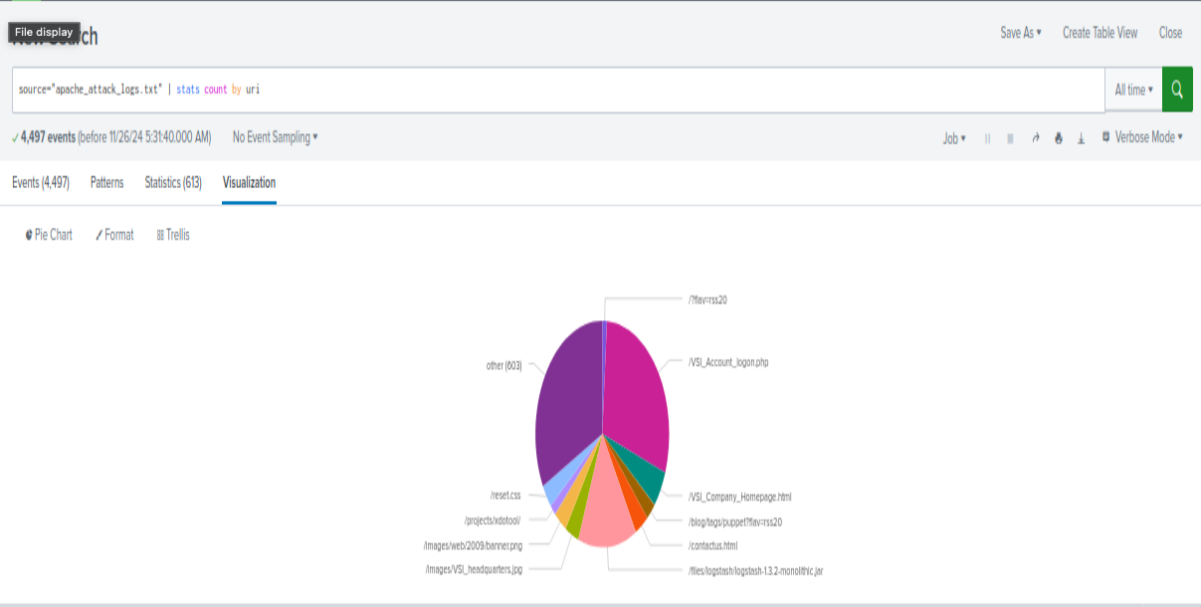
Dashboard Analysis for URI Data - Attack Logs
Based on the URI being accessed the attacker could potentially be trying a brute force attack or an SQL injection.

Slide 48
Attack Analysis
‹#›

Slide 49
Attack Summary—Windows
Summarize your findings from your reports when analyzing the attack logs.
Analysis of Windows attack logs revealed notable malicious activity patterns.
Significant increase in successful activities alongside a decrease in failed attempts, indicating a shift in access patterns.
High-severity events surged from 7% to 20%, signaling a sharp escalation in critical activity.
Findings suggest a targeted and sophisticated intrusion.

Slide 50
Attack Summary—Windows
Summarize your findings from your alerts when analyzing the attack logs. Were the thresholds correct?
On March 25, 2020, at 8:00 AM, 35 failed Windows activities exceeded the threshold of 15, successfully notifying the SOC and confirming the threshold’s effectiveness.
Irregular login activity dropped from 16 successful logins at 8:00 AM to 0 by 10:00 AM but did not trigger an alert as it fell below the threshold of 30, indicating a need for adjustment.
A spike in user_a logins at 2:30 AM (10 events) was detected.
A suspicious decrease in account deletions occurred between 9:00 AM and 11:00 AM.
Findings suggest opportunities to refine thresholds to improve detection while minimizing alert fatigue.
Additional log analysis is recommended to enhance detection settings.

Slide 51
Attack Summary—Windows
Summarize your findings from your dashboards when analyzing the attack logs.
- Dashboard analysis revealed significant spikes in two key activities:
- Password reset attempts: 1,268 events.
- Account lockouts: 896 events.
- Two users showed unusually high activity levels:
- user_a: 984 events.
- user_k: 1,256 events.
- These activity spikes suggest targeted attempts to compromise or disrupt specific accounts.
- Findings indicate a focused attack pattern on user accounts.

Slide 52
Attack Summary - Apache
Summarize your findings from your reports when analyzing the attack logs.
There was a significant increase in POST and HTTP methods
HTTP Response Codes report showed that ‘404’ jumped from 2.13% to 15.09%
We also saw some changes in the results of the top 10 referrer domains, specifically with the last 5 of the list

Slide 53
HTTP 404 Error Jump
POST response codes saw an increase of 1,185%

Slide 54
Attack Summary - Apache
Summarize your findings from your alerts when analyzing the attack logs. Were the thresholds correct?
Our alert detected a large spike in international activity on March 20, 2020
At around 12 am there were 937
The threshold for international activity will remain (150/hr) the same, however, it should be monitored more frequently
Our second alert checking for HTTP POST activity detected a suspicious volume of activity at around 8:00pm on March 25, 2020, racking up a total count to 1296.
The threshold previously selected was every 15 minutes, but after reviewing the data, reducing that time down to every 10 minutes would be beneficial for catching suspicious activity much quicker.

Slide 55
Attack Summary - Apache
Summarize your findings from your dashboards when analyzing the attack logs.
Our dashboard analysis revealed 3 key components to identifying malicious activity.
First being a significant spike in the POST and GET methods. Comparing the normal logs to the attack logs, we can see the largest increase in the POST method racking up 1,296 requests between the hours of 7:00pm to 9:00pm
Next, when analyzing the Cluster Map Dashboard and searching for any activity outside of the USA, we saw a major increase in the cities of Karkhev and Kiev, bringing up their activity totals to 440 and 432 respectively. This highlights to us where the attacks likely took place, allowing us to further secure against these locations.
Lastly, when searching the top URIs, we can see a major increase in the ‘VSI_Account_logon.php’ URI, indicating that the attacker could be trying a brute force attack or SQL Injection. Factoring in the large amounts of 404 errors would help better narrow it down to an attacker using brute force rather than SQL injection.

Slide 56
Summary and Future Mitigations
‹#›

Slide 57
Project 3 Summary
The attack revealed significant vulnerabilities, including increased high-severity events, suspicious user activities, and abnormal HTTP method usage, indicating potential brute force and reconnaissance attempts. Malicious activity was also linked to international traffic and targeted URIs, highlighting gaps in access controls and traffic monitoring.
To mitigate:
Strengthen Access Controls
MFA
Account Lockouts
Enhance Traffic Monitoring and Filtering
Web Application Firewall
Geofencing and Rate limiting devices
Patch Management
regular updates

